Slide 1
Transform CSCU 2020 Charter Oak State College Town Hall
Agenda
Introduction to Transform
Goals for Transform, and “Value Proposition”
Initiative Clusters, Spotlight
Transform at COSC
Discussion and Q&A
What's next, and how to get involved

Slide 2
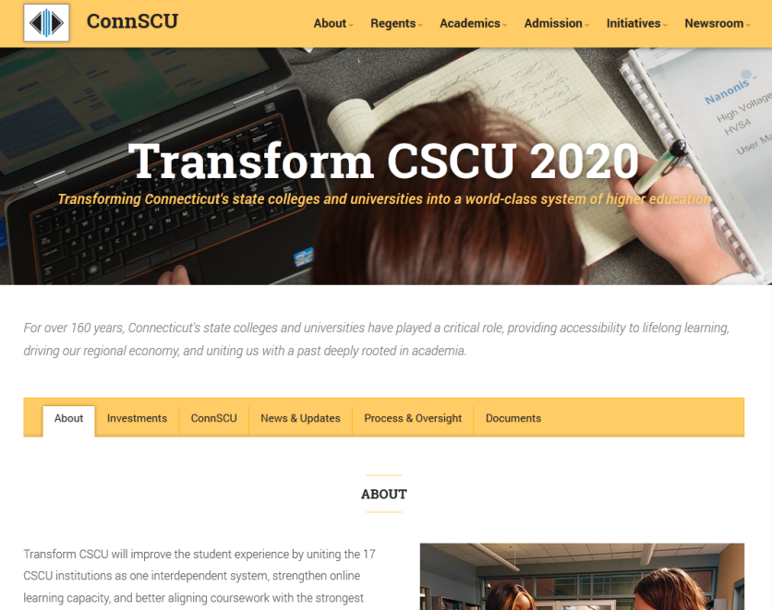
A Little Background…
From California to Connecticut…
“We need a plan…”
“…and I’ve got the money.”
Feb. 2014: Transform is announced
7 months later, a plan is starting to take shape

Slide 3
You May Ask: What is Transform?
A plan to unite CSCU institutions into one system, and
Increase affordability and accessibility for students
Make CSCU an economic engine for Connecticut
Improve the overall student experience
Implement initiatives in 7 key areas

Slide 4
A Plan Based on the BOR’s Goals
A Successful First Year Increase the number of students who successfully complete a first year of college.
Student Success Graduate more students with the knowledge and skills to achieve their life and career goal.
Affordability and Sustainability Maximize access to higher education by making attendance affordable and our institutions financially sustainable.
Innovation and Economic Growth Create educational environments that cultivate innovation and prepare students for successful careers in a fast changing world.
Equity Eliminate achievement disparities among different ethnic/racial, economic, and gender groups.

Slide 5
…And Why Should You Care?
Making college available to more people
Producing better educated, more highly skilled graduates
Improving facilities, classrooms and IT infrastructure
Helping to insulate the System from adverse state budget impacts
Stay ahead of the higher education revolution

Slide 6
CSCU 2020 Value Proposition
A standard to guide our decisions and actions
⇩

Preparation to Achieve
Life & Career Goals
Quality Student Experience
Academic rigor and superior learning
Targeted services (e.g., embedded tutoring)
Enhanced academic advising
Programs aligned to workforce needs
High-caliber faculty
Student diversity
Enhanced career-related programming
Expanded partnerships with businesses
Academic programs tied to workforce needs
STUDENTS
−

Superior Course & Program Access
Affordable Price
Flexible options for online offerings
Improve transfer & articulation
State of the art classrooms
Cross-registration options
Degree variety
Lowest tuition in state of Connecticut
Efficient path to degree
Enhance financial aid support

Slide 7
Stakeholders in Transform Planning
Board of Regents
Business & Civic community
Faculty & Staff
Presidents
Students
Legislature

Slide 8
Transform at This Moment
Spring - Summer 2014
Fall 2013
Fall 2014
2015-2016
2020
Conducted institution tours to collect input
Developed preliminary set of Transform initiatives
Preliminary conversations between the Governor and CSCU leadership on opportunities with Transform
Commitment of $125M to CSCU by Governor in State of State address
Gathered additional input from stakeholders
Revised initiatives based on stakeholder input
Begin initiative planning and built fact base to inform options for future-state system
Continuing to gather stakeholder input
Developing and refining initiatives…
Preparing to present all initiatives and implementation plans to the Board
Begin drafting Transform Report (Board approval targeted for Jan-Mar 2015)
Continue to gather input through initiative teams
Support ongoing implementation
Refine initiative plans in light of evolving context
Target for full execution of Transform plan
Articulation of success as a result of pursuing Transform, including how CSCU as a system is better educationally for our students

Slide 9
Transform Initiatives Academic (I) Cluster
INITIATIVE GROUP | INITIATIVE | EXECUTIVE SPONSOR
Attracting & Recruiting Students | Establish/grow early college programs at CC's | DeFilippis (DDeFilippis@nv.edu)
 | Cross campus registration and admissions | DeFilippis
 | Go Back to Get Ahead | DeFilippis
 | Veterans recruitment | DeFilippis
 | Recruit non-resident students | Schmotter (SchmotterJ@wscu.edu)
 | Improve opportunities for study abroad | Schmotter
 | Graduate student recruitment | Schmotter
Student Retention | Academic advising | Jukoski (MJukoski@threerivers.edu)
 | First year student experience | Jukoski
Enhance Academic Offering | Academic Program Optimization | Nunez (Nunez2020@easternct.edu)
 | K-12 alignment PA 12-40 | Nunez
 | Academic Centers of Excellence | Nunez
 | Strengthen liberal arts core | Nunez
 | Faculty skill and development: | Nunez
 | Research for graduate students | Nunez

Slide 10
Transform Initiatives Academic (II) and Workforce Clusters
INITIATIVE GROUP | INITIATIVE | EXECUTIVE SPONSOR
Transfer & Articulation | Seamless system wide transfer | Gargano (MGargano@commnet.edu)
 | Philanthropic campaign to transfer from CC to CSU | Gargano
Instructional Innovation | Build state of the art classrooms | Tolisano (JTolisano@commnet.edu)
 | Blended learning and online course delivery | Papazian (Papazianm1@southernct.edu)
 | Study skills for online/distant learning | Papazian
Student Services | Evening and after hours support | Glickman (GGlickman@mcc.commnet.edu)
 | Invest in co-curricular student experience & res. life | Glickman
 | Enhanced career services | Glickman
Workforce of Tomorrow | Labor needs & workforce programs | Nieves (WNieves@ccc.commnet.edu)
 | Career-related programs (e.g., P-Tech) | Nieves
 | Collaboration with business community | Nieves
 | Career pathway alignment – CT Tech. | Nieves

Slide 11
Transform Initiatives Non-Academic Clusters
INITIATIVE GROUP | INITIATIVE | EXECUTIVE SPONSOR
Transparency | System-wide policy transparency | Kozlowski (MKozlowski@commnet.edu)
 | Shared metrics | Kozlowski
Revenue Management | Revenue Management | Steiner (ESteiner@commnet.edu)
Efficiency | Organizational effectiveness & efficiency | Steiner
IT | IT systems assessment | Tolisano (Jtolisano@commnet.edu)
 | IT organizational structure | Tolisano
Facilities | Facilities master plan | Epstein (epsteink@ct.edu)
 | Code compliance/infrastructure improvement | Epstein
Note: One of the thirty-six initiatives, Common Calendar, is complete.

Slide 12
Academic Initiatives Spotlight System-Wide Metrics
Focus of initiative to date
Identified 25 shared metrics to measure performance against BOR goals
Agreed on points of comparison and peer groups
Goal
Metric
Progress

Slide 13
Academic Initiatives Spotlight Smart Classrooms
Progress to date
Assembled team, defined mission and scope, and conducted brainstorming sessions
Subjected research to peer review
Conducted review of current technology/tool portfolio
Reviewed applicable CT contracting rules
Met with vendors, conducted campus tours, and evaluated dependencies
Next Steps
Create e-learning eco systems
Review alignment with Transform goals
Ensure portability of classroom innovation across multiple platforms for maximum adoption

Slide 14
Academic Initiatives Spotlight Smart Classrooms
Full implementation Fall 2015
March 2014
Summer 2014
Fall 2014
Spring 2015
Plan & Organize
Prototype Test & Design
Institution based Pilot

Slide 15
Transform at Charter Oak
How Charter Oak is involved
Greatest opportunities for COSC
Incorporated 2020 into strategic plan
Shared with faculty committees
Information sent to students and faculty
Staff participating on various transform committees
At Charter Oak:
Go Back To Get Ahead
Veteran’s Recruitment
Out of state recruitment
New program development
Academic advising: new student orientation, PLA, tutoring
Redesigned new faculty orientation
Seamless transfer
Study skill for online students
For System:
Online solution for low enrolled courses
PLA

Slide 16
How to Get Involved
Get involved in an initiative, or send your comments or questions
Contact the Executive Sponsor in the cluster in which you are interested
Contact Charter Oak’s Campus Liaison, Dr. Shirley Adams, at sadams@charteroak.edu
Contact Michael Kozlowski at mkozlowski@commnet.edu

